Slide 1
PowerBI analysis
UWE Formula
By: Faisal Ibrahim Abdul-Fattah

Slide 2
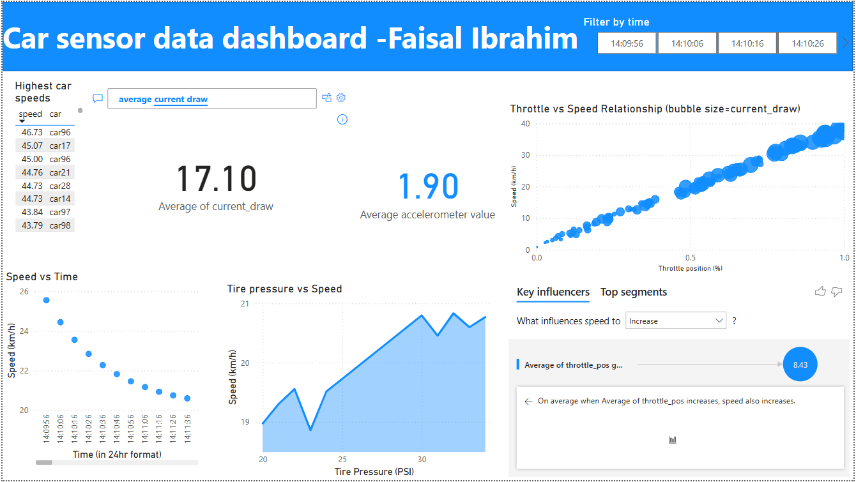

Slide 3
Highest speed achieved was about 47 km/hour
The average current drawn by the cars was about 17 A (this q and a is interactive please ask the PowerBI other questions if you wish)
Average acceleration was about 2m/s^2
Throttle and speed have a positive correlation
Speed and Current have a positive correlation

Slide 4
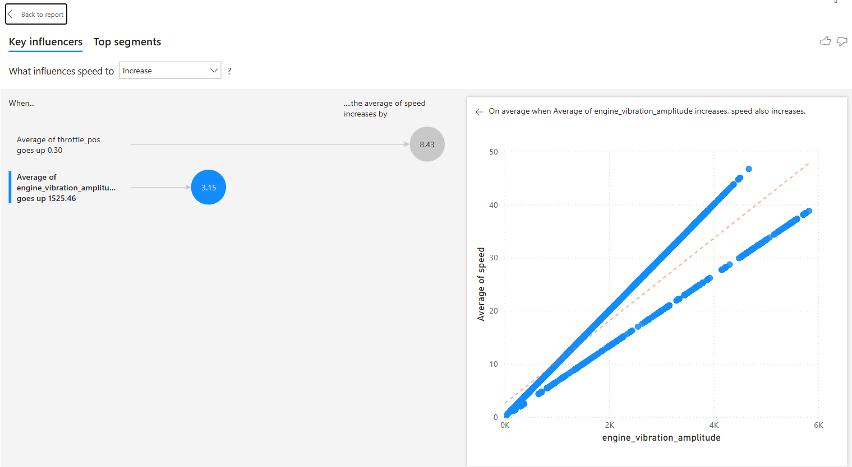
Throttle and Current have a positive correlation
As expected, as speed increases, the finish time is earlier. However, the rate that speed slows down with time taken, decreases over time.
Generally, there is a positive correlation between tire pressure and speed.
If average throttle position is up by 0.30 (i.e. 30%) then average car speed goes up by 8.5 km/hr
If average of engine vibration amplitude goes up by about 1500 mg, then the average speed goes up by 3.15 km/h

